Slide 1
E-Commerce Website
Presented by
Krushna dige

Slide 2
INTRODUCTION
The Shopping-WEB project is a basic e-commerce website that allows users to browse, select, and purchase products online. It provides functionalities for user registration, login, product listing, adding items to a cart, and placing orders. The admin has control over product management, ensuring the platform remains updated. The website serves as a practical solution for understanding online shopping operations and offers a hands-on experience of developing a dynamic, database-driven shopping portal.

Slide 3
OBJECTIVES
To create a user-friendly online shopping platform.
To allow customers to register, browse products, add items to a cart, and place orders easily.
To provide an admin panel for managing products, categories, and orders

Slide 4
Software & Hardware Requirements
Software:
Web Browser (Chrome, Firefox, Safari)
Text Editor (VS Code, Sublime Text)
Web Server (for local development, such as XAMPP or WAMP)
HTML for frontend development
Hardware:
A computer or laptop with at least 4GB of RAM
Internet connectivity for browsing and testing

Slide 5
Feasibility Study
The Shopping-WEB project is technically feasible since it uses standard web technologies (HTML) and can be implemented with minimal resources. The project doesn't require complex backend or database integration, making it easy to develop and maintain. Operationally, it is a simple static website suitable for small-scale businesses. Financially, the project is cost-effective, as it can be launched with low initial costs, mainly for domain and hosting.

Slide 6
System Analysis
The Shopping-WEB project is a basic static website that does not involve complex backend systems or databases. It relies solely on HTML for its structure and layout, making it simple to deploy and maintain. The system's primary function is to display products, provide contact details, and offer a basic informational platform for users. There are no interactive features like user accounts or dynamic content at this stage.

Slide 7
Proposed System & Advantages
Proposed System:-
The Shopping-WEB project aims to create a simple static e-commerce website where users can view products, read basic information, and get in touch with the seller. It will feature easy navigation and provide essential pages for showcasing products, contact details, and company information.

Slide 8
Advantages
Simple and Cost-Effective: Minimal development and maintenance costs.
Easy to Deploy: No complex backend or database is required.
User-Friendly: Clean layout and easy navigation for visitors.

Slide 9
Design
ER Diagram:
Data Dictionary:
Input & Output Screens
Limitations of the Website:
Static Content: The website lacks dynamic features like user accounts, product search, or real-time updates.
No Backend Integration: There is no database for managing products or user data.
Limited E-commerce Features: No payment integration or cart functionality.
No Responsiveness: The website is not optimized for mobile devices or varying screen sizes.
Minimal Design: The website lacks advanced features such as interactive elements or animations.

Slide 10
Future Enhancement
Dynamic Content: Add backend integration to manage products, user accounts, and orders.
E-commerce Features: Implement a shopping cart, product search, and payment gateway for complete online shopping functionality.
Responsive Design: Ensure the website is mobile-friendly and works across various screen sizes.
SEO Optimization: Improve visibility on search engines to attract more visitors.
Interactive UI Elements: Add animations, transitions, and hover effects for better user engagement.

Slide 11
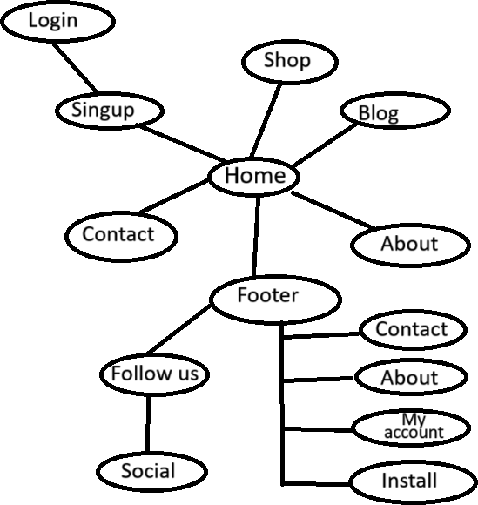
ER Diagram

Slide 12
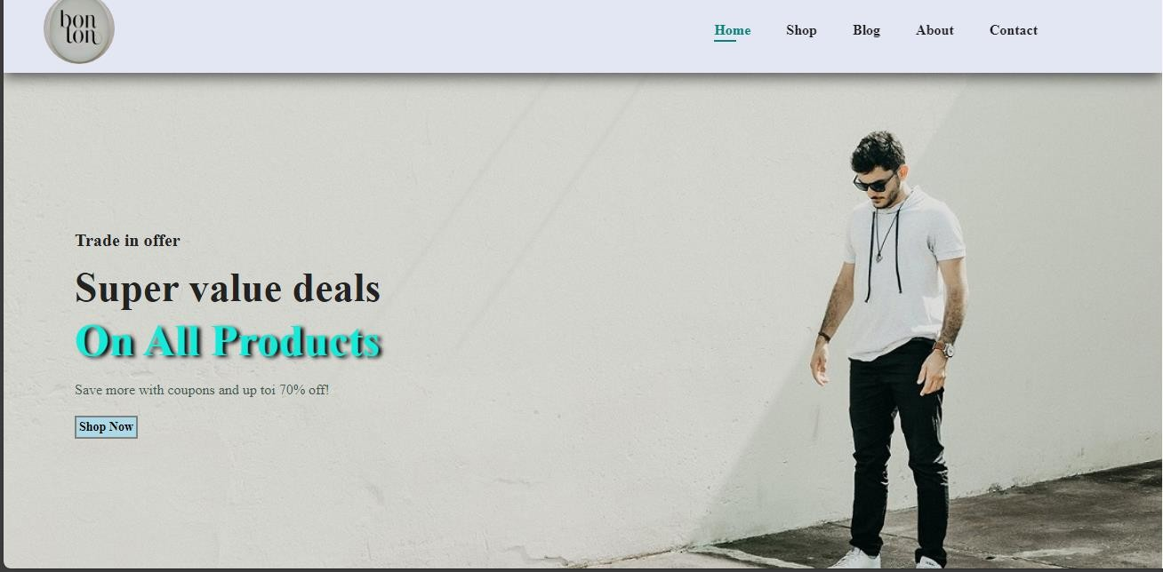
HOME PAGE

Slide 13
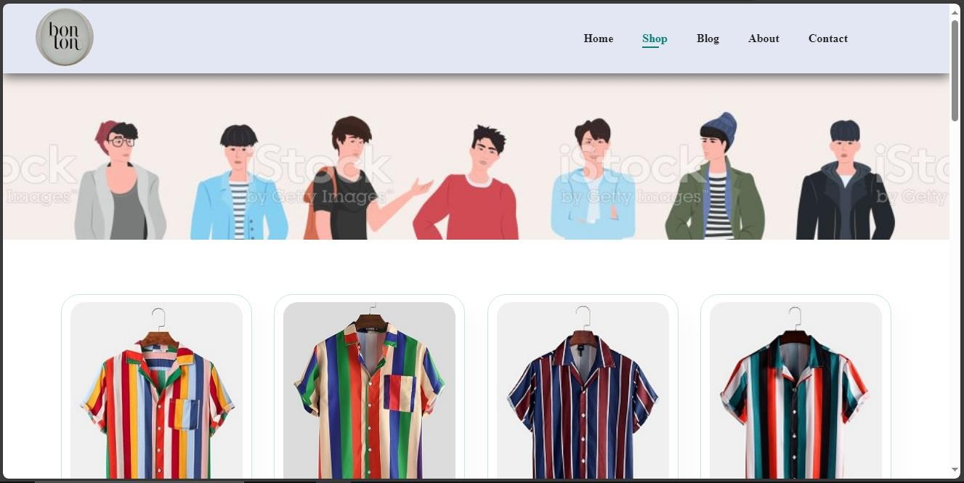
SHOP PAGE

Slide 14
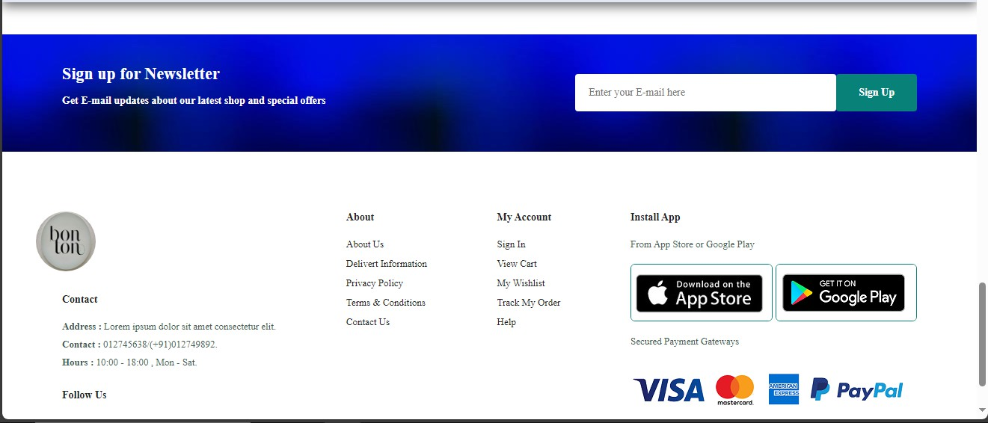
SIGN UP PAGE

Slide 15
Bibliography
W3Schools: Offers tutorials and references on HTML, CSS, JavaScript, and web development technologies. Link toW3Schools
MDN Web Docs: Comprehensive documentation on web standards and best practices. Link to MDN
FreeCodeCamp: Provides guides and tutorials on web design and development, including responsive design. Link to FreeCodeCamp

Slide 16
Thank you

